Slide 1
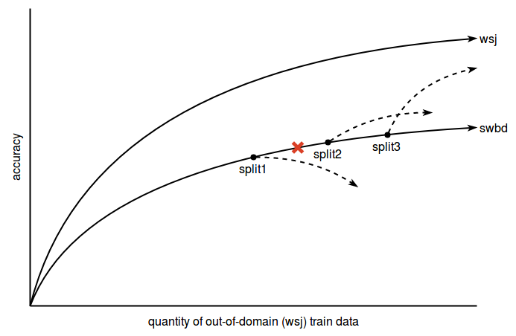

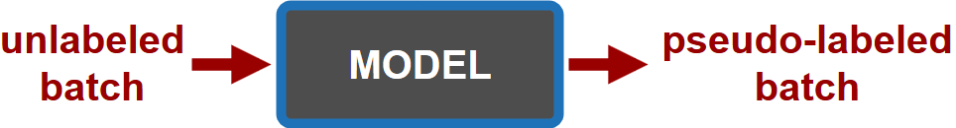
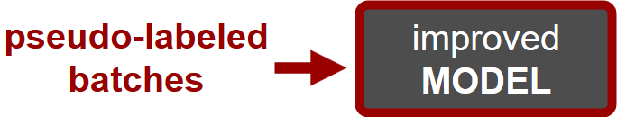
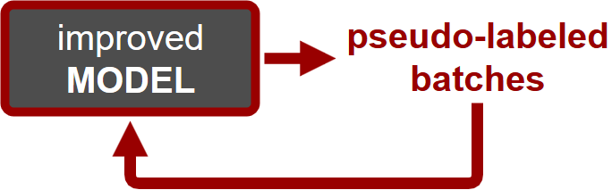
DOMAIN ADAPTATION FOR SPEECH RECOGNITION THROUGH SEMI-SUPERVISED LEARNING
Oliver Bentham Dr. Stephen LaRocca
Introduction
Semi-Supervised Learning is a type of machine learning that makes use of unlabeled data for training to improve accuracy, and has been shown to work in Automatic Speech Recognition^{[1]}.
Domain Adaptation is the process of modifying a model trained on data from a specific source domain to improve performance on a target domain.
Our goal is to find the smallest quantity of out-of-domain speech data to train a speech recognition system whose predictions on unlabeled in-domain data improve accuracy during semi-supervised learning.
Motivation
The Multilingual Computing and Analytics Branch at ARL has speech-to-speech devices deployed with soldiers in noisy, conversational environments.
Most speech data available in low-resource languages is clean audio from parliamentary proceedings or TV news
A method to train low-resource, robust ASR models for everyday speech would benefit most ASR applications
Data
We use two very common English ASR corpora, Wall Street Journal (WSJ) and Switchboard (SWBD)
Approach
1. Prepare the data. Split the out-of-domain WSJ
training data into subsets
2. Train a model. Using Kaldi, train an LF-MMI chain
model^{[2]} on each of the WSJ training subsets to get
split1, split2, split3, etc.
3. Assign pseudo-labels. Use each split’s model to
assign pseudo-labels to a batch of the unlabeled
SWBD data
4. Train improved model. Continue to train the model
on the pseudo-labeled SWBD batch to get an
improved model
5. Repeat. Return to step 3 with improved model and incorporate another SWBD batch
Hypothesized Results
Results
Baseline Word Error Rates for splits
prior to semi-supervised learning
Future Work
1. Test with different languages and different domains
2. Experiment with different language models
3. Investigate different neural architectures
References
[1] Manohar, V., Hadian, H., Povey, D., & Khudanpur, S. (2018). Semi-Supervised
Training of Acoustic Models Using Lattice-Free MMI. 2018 IEEE International
Conference on Acoustics, Speech and Signal Processing (ICASSP).
doi:10.1109/icassp.2018.8462331
[2] Povey, D., Peddinti, V., Galvez, D., Ghahremani, P., Manohar, V., Na, X., . . .
Khudanpur, S. (2016). Purely Sequence-Trained Neural Networks for ASR Based
on Lattice-Free MMI. Interspeech 2016. doi:10.21437/interspeech.2016-595
wsj training utterances | wsj test set | swbd test set
5k | 11.67 | 94.76
10k | 9.03 | 86.95
15k | 7.60 | 85.98
20k | 7.23 | 83.74
25k | 7.20 | 72.96
30k | 7.03 | 79.91
speech corpus | domain |  | labeled/ transcribed
Wall Street Journal | out-of-domain | edited news clean | yes
Switchboard | in-domain | conversational phone noisy | no

